Slide 1
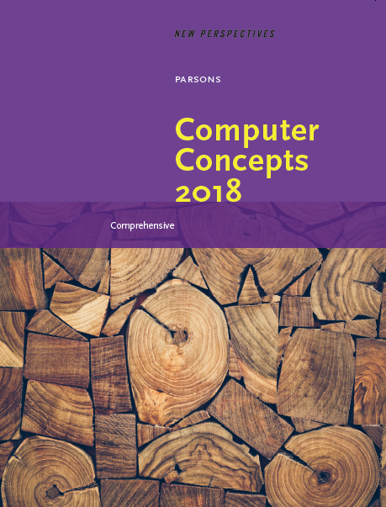

Computer Concepts 2018
Module 4 The Web
Copyright © 2019 Cengage. All rights reserved.

Slide 2
Module Contents
Section A: Web Basics
Section B: Browsers
Section C: HTML
Section D: HTTP
Section E: Search Engines

Slide 3
Section A: Web Basics
Web Overview
Evolution
Web Sites
Hypertext Links
URLs

Slide 4
Section A: Objectives (1 of 3)
List the four essential technologies that are the foundation of the World Wide Web
Summarize the key events in the emergence of the modern Web
Draw a diagram showing the hierarchy of the following: Web server, Web sites, Web pages, hypertext links

Slide 5
Section A: Objectives (2 of 3)
Describe a situation in which bidirectional hypertext links would improve your online research experience
Give an example of the URL for a Web site home page, one for a Web page that is stored in a folder, and one for a Web page that is produced based on a query

Slide 6
Section A: Objectives (3 of 3)
State four rules for correctly typing URLs
Define the term linkrot
Describe a situation in which you might use a short URL service
Explain the difference between a URL and a domain name

Slide 7
Web Overview (1 of 2)
The Web is not the Internet
The Internet is a global data communications network
The Web is just one of the many technologies that use the Internet to distribute data

Slide 8
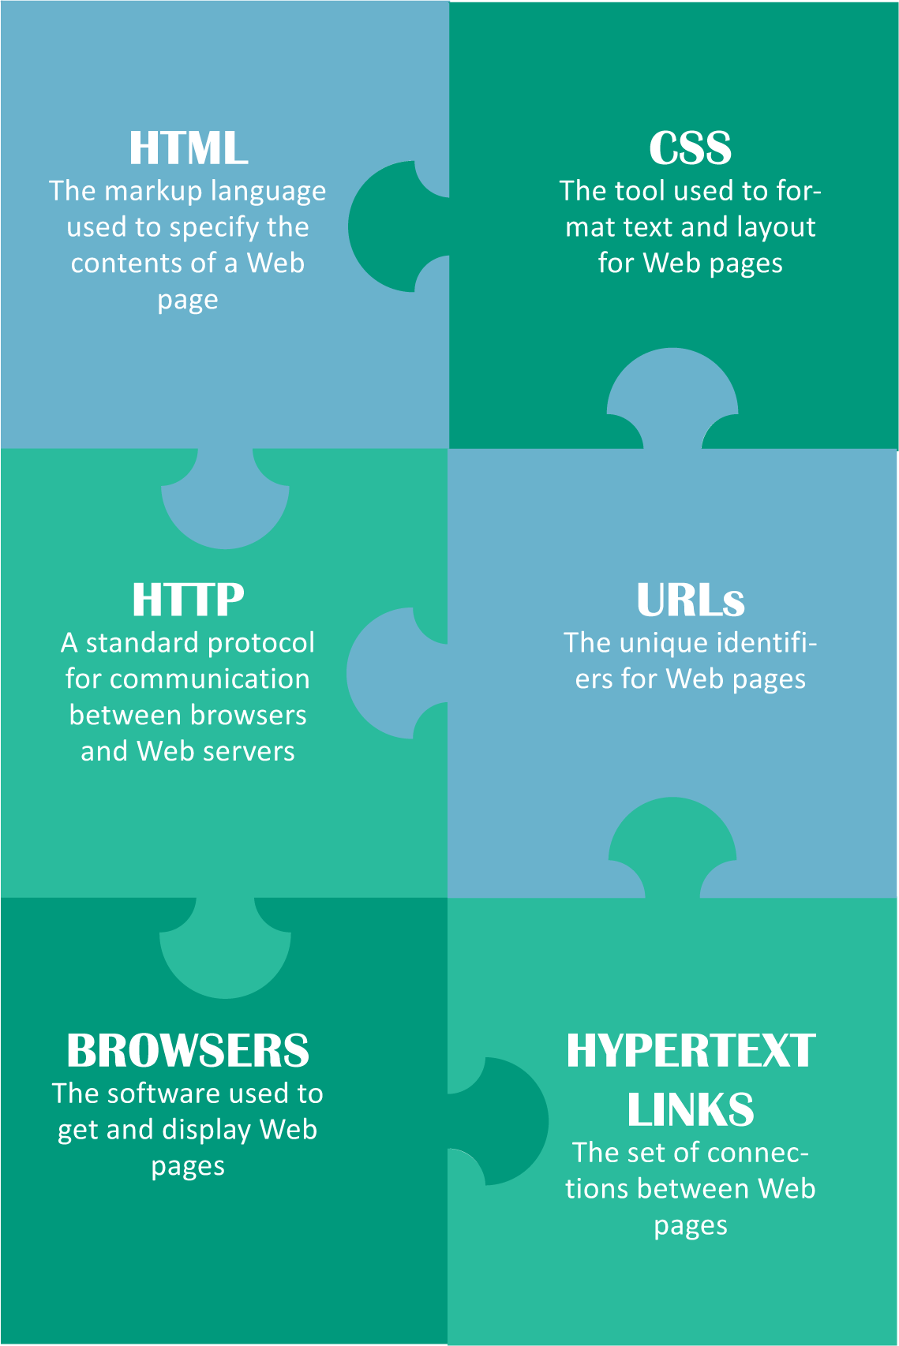
Web Overview (2 of 2)
The World Wide Web (usually referred to simply as the Web) is a collection of HTML documents, images, videos, and sound files that can be linked to each other and accessed over the Internet using a protocol called HTTP

Slide 9
Evolution (1 of 4)
In 1993 there were a total of 130 Web sites; by 1996 there were 100,000 Web sites
Today, there are more than a billion Web sites and new sites appear every day
Ted Nelson coined the term hypertext to describe a computer system that could store literary documents, link them in logical relationships, and allow readers to comment and annotate on what they read

Slide 10
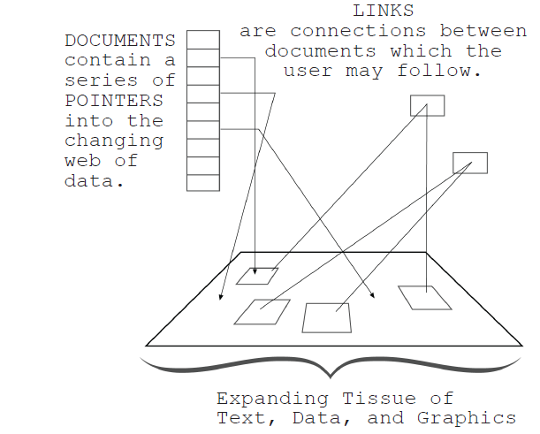
Evolution (2 of 4)
Ted Nelson sketched his vision for project Xanadu in the 1960s.Notice his use of the terms web and links, Which are now familiar to everyone who uses the World Wide Web.

Slide 11
Evolution (3 of 4)
In 1990 British scientist Tim Berners-Lee developed specifications for URLs, HTML, and HTTP — the foundation technologies of today’s Web
Berners-Lee created the Web browser software Nexus
In 1993 Marc Andreessen at the University of Illinois created the Web browser Mosaic that led to the development of the popular browser Netscape

Slide 12
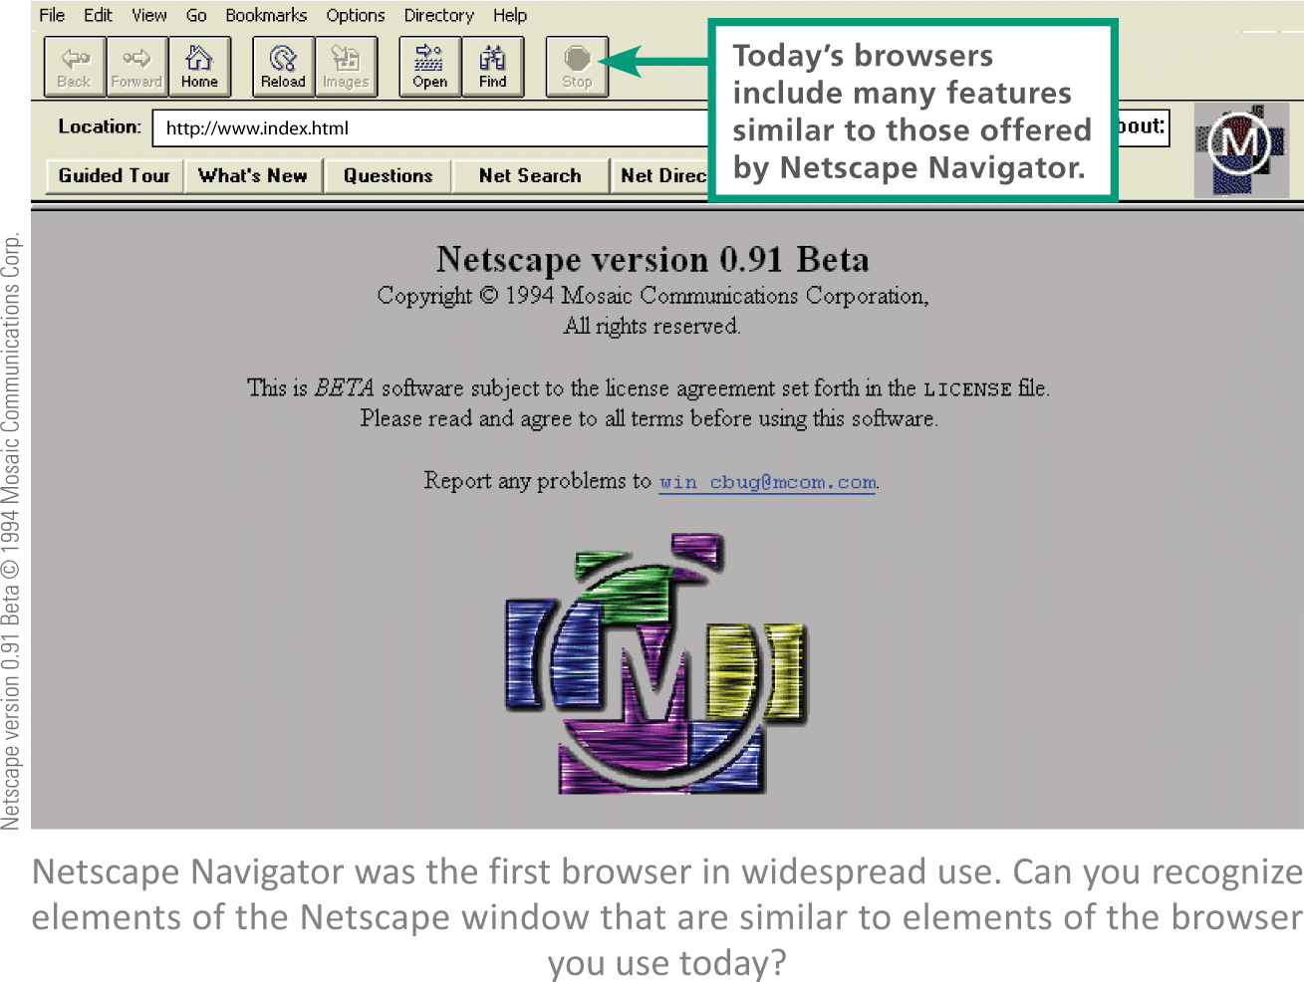
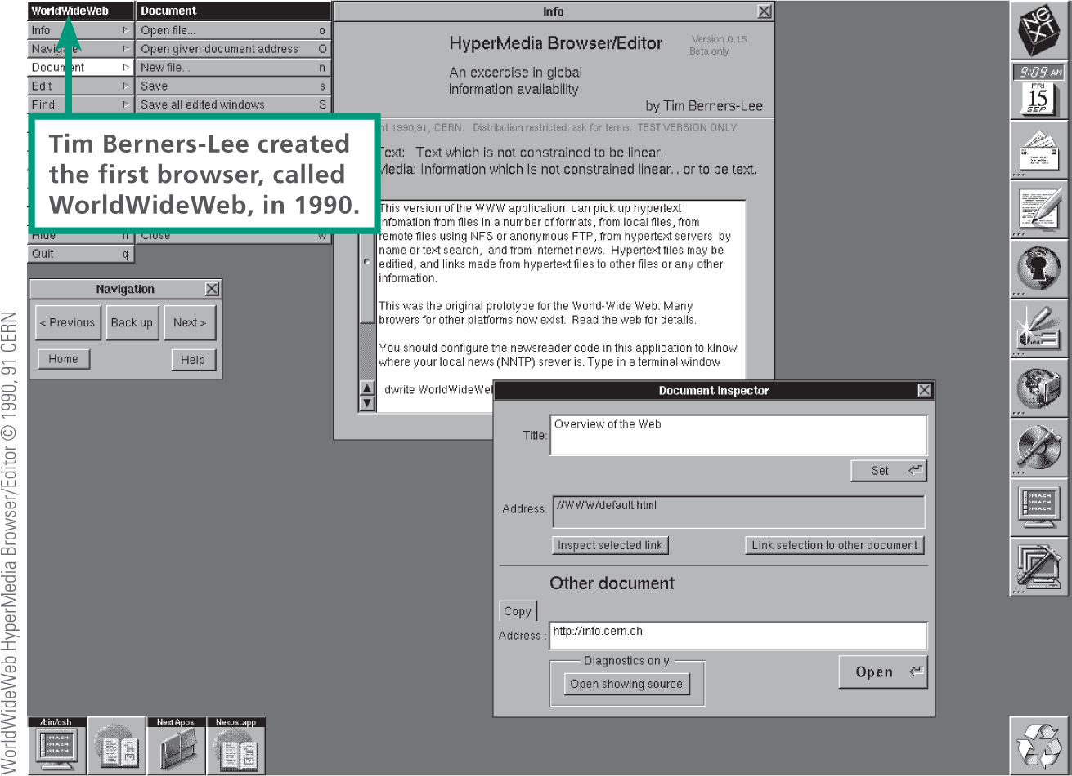
Evolution (4 of 4)

Slide 13
Web Sites (1 of 2)
A Web site typically contains a collection of related information organized and formatted so it can be accessed using a browser
A Web server is an Internet-based computer that stores Web site content and accepts requests from browsers
A Web page is based on an HTML source document that is stored as a file on a Web server

Slide 14
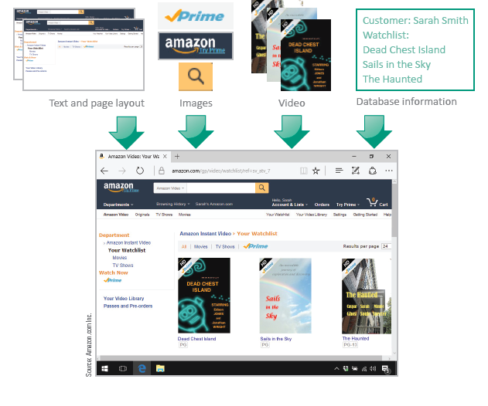
Web Sites (2 of 2)

Slide 15
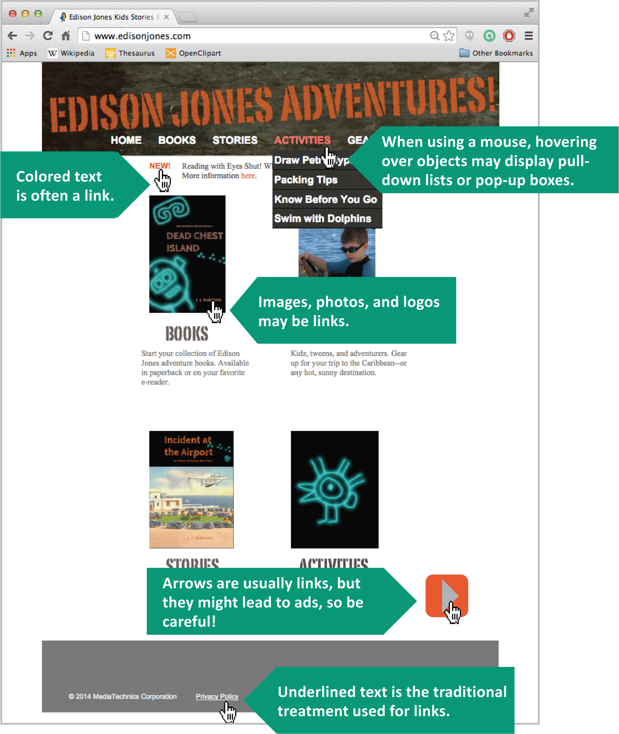
Hypertext Links (1 of 2)
Web pages are connected by hypertext links (commonly referred to simply as links)
Links are commonly indicated by the underlined or colored text, a photo, button, tab, or object

Slide 16
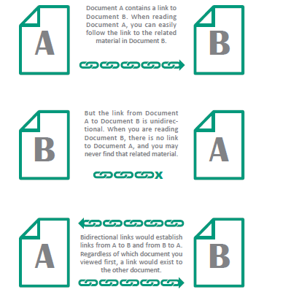
Hypertext Links (2 of 2)
Web pages have unidirectional links; Document A links to Document B, but not vice versa
Bidirectional links connect two documents using a two-way link that can be followed from either document

Slide 17
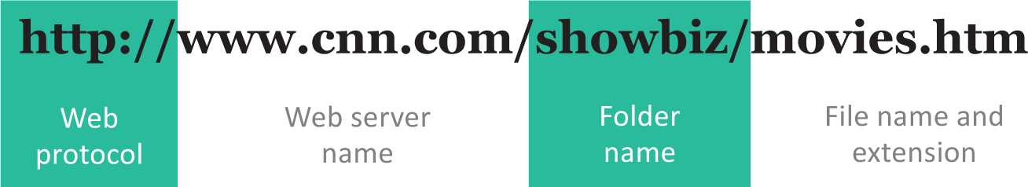
URLs (1 of 7)
Every Web page has a unique address called a URL (Uniform Resource Locator, pronounced “you are ELL”)
Most URLs begin with http:// to indicate the Web’s standard communications protocol
The file name of a specific Web page always appears last in the URL

Slide 18
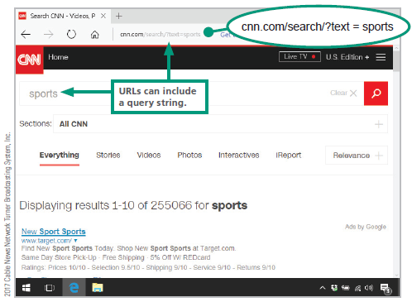
URLs (2 of 7)
Some URLs contain a search string rather than the name of an HTML document

Slide 19
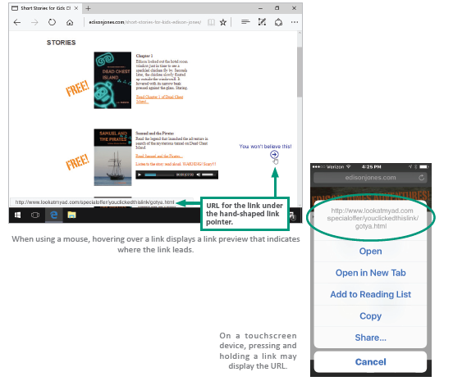
URLs (3 of 7)
Rules for correctly typing a URL:
A URL never contains spaces
The http:// can be omitted
Always use a forward slash (/)
Duplicate the URL’s capitalization exactly —some Web servers are case sensitive
Links aren’t URLs, but a link contains the URL that “links” to another Web page

Slide 20
URLs (4 of 7)
Many URLs are long and complex; this can be a problem
Several services, such as Bitly and Goo.gl, create short URLs
Copy and paste the full URL into the box provided by a short URL service such as Goo.gl.
The service produces a short URL.
The short URL is stored on the server along with the full URL.
Links to the short URL are directed to the server, which forwards the link to the full URL

Slide 21
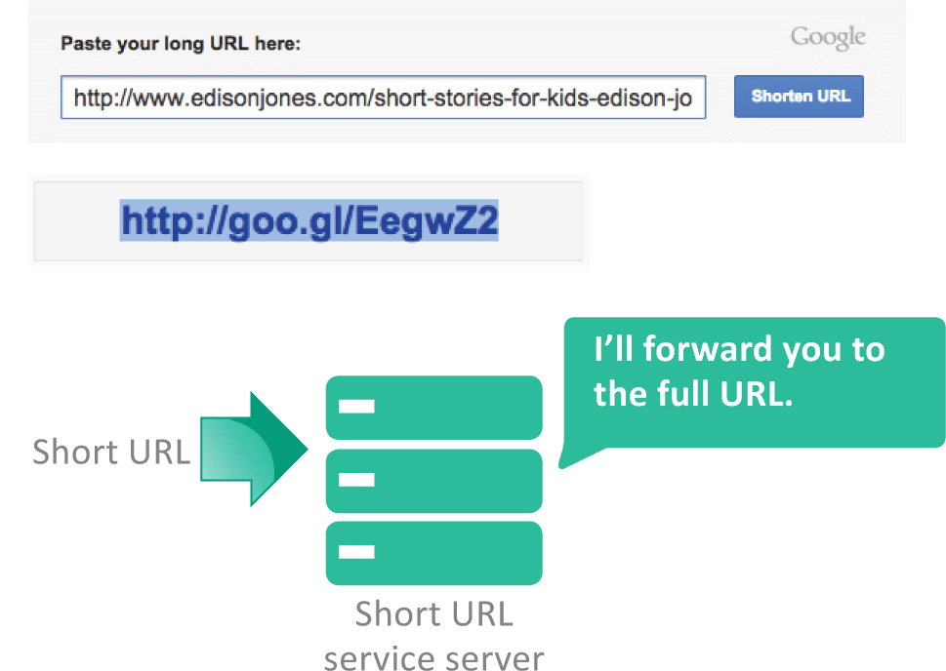
URLs (5 of 7)

Slide 22
URLs (6 of 7)
Short URL services may lead consumers to believe that all short URLs will last forever
Short URLs are sometimes used to disguise the real address of a Web site that is illegitimate
Short URL services may be blocked by Web hosts and ISPs
Web surfers should be aware that short URLs may lead to questionable Web sites and scams

Slide 23
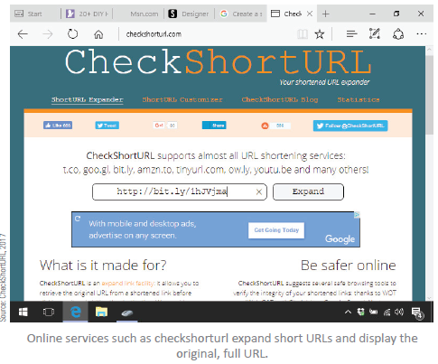
URLs (7 of 7)

Slide 24
Section B: Browsers
Browser Basics
Customization
Browser Cache

Slide 25
Section B: Objectives (1 of 2)
Identify the following elements of a browser window: address box, refresh and home buttons, back and forward buttons, tabs, and settings menu
List four popular browsers
State the difference between the default browser and the browser home page

Slide 26
Section B: Objectives (2 of 2)
Explain the purpose of predictive services
Describe the difference between a browser extension and a plugin
Describe what is in a browser cache and explain how it can affect your privacy

Slide 27
Objectives
Describe what is in a browser’s history list
Explain how private browsing works
Summarize the potential problem with allowing your browser to store passwords

Slide 28
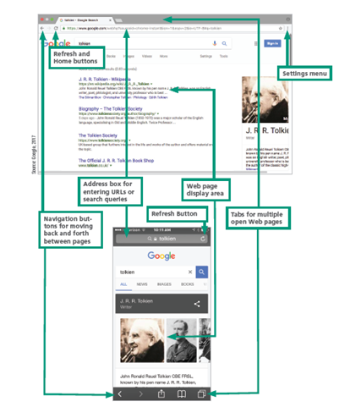
Browser Basics (1 of 3)
The essential elements of a browser include:
An entry area for URLs and searches
Navigation controls
A refresh button
A home button
A settings menu
And a display area

Slide 29
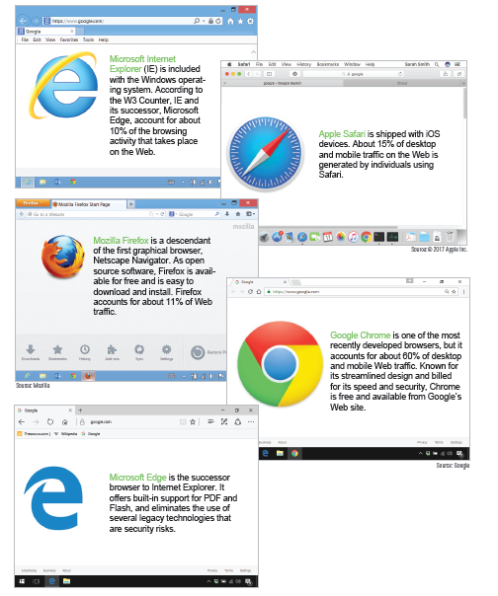
Browser Basics (2 of 3)
Today’s most popular browsers are:
Apple Safari
Google Chrome
Microsoft Internet Explorer (IE)
Microsoft Edge
Mozilla Firefox

Slide 30
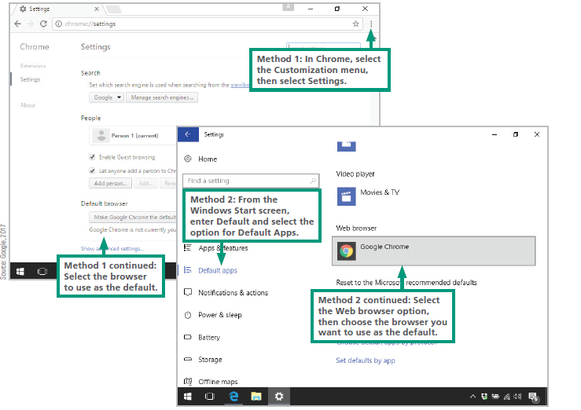
Browser Basics (3 of 3)
You can designate a default browser so that it is automatically used when you click a link in an email message or PDF file

Slide 31
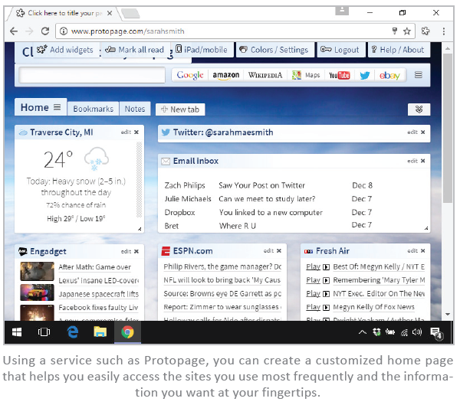
Customization (1 of 8)
You can customize your browser by doing the following:
Change your home page
Customize bookmarks and favorites
Control tab behavior
Select predictive services
Adjust password settings

Slide 32
Customization (2 of 8)
The browser home page is the first page displayed when the browser starts
If your primary use of the Web is seeking information, then a search engine site, such as Google, makes a good home page
You can also use services such as Protopage, My Yahoo, or uStart to design your own start page

Slide 33
Customization (3 of 8)
Predictive services look ahead and anticipate what you might do when searching or filling out forms while using a browser. These services can automatically fill in form data based on entries you’ve made to earlier forms

Slide 34
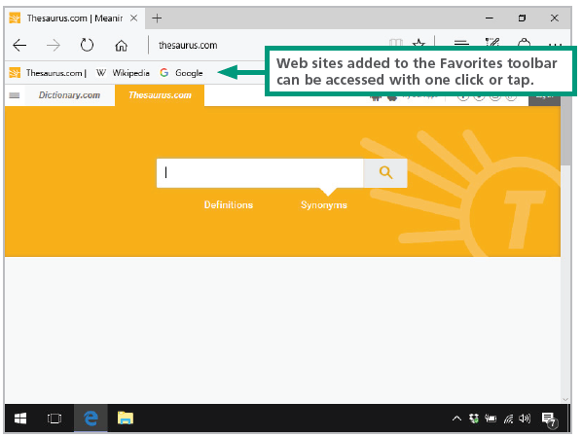
Customization (4 of 8)
Bookmarks (or Favorites, as they are called in Microsoft browsers) link to pages that you use frequently

Slide 35
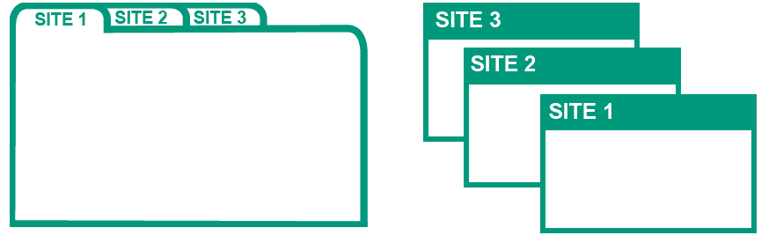
Customization (5 of 8)
Browser tabs allow your browser to queue up multiple Web pages so that you can easily switch between them

Slide 36
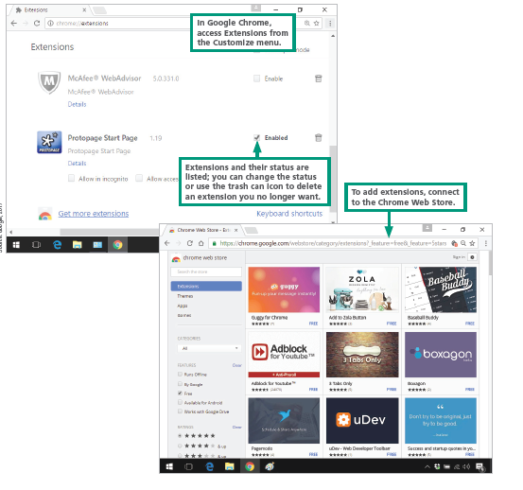
Customization (6 of 8)
A browser extension adds features to a browser
Browsers provide a list of installed extensions and provide tools for disabling, enabling, or deleting them

Slide 37
Customization (7 of 8)
A plugin is a program that extends a browser’s ability to work with file formats. Popular plugins include Adobe Reader for viewing PDF files, Adobe Flash Player for animations, and QuickTime Player for videos
Plugins have been exploited by hackers to access computers without authorization and plant malware

Slide 38
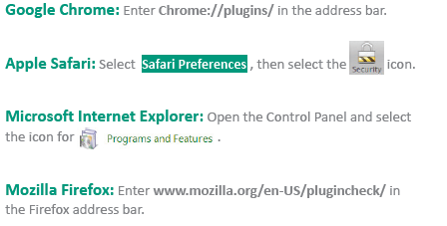
Customization (8 of 8)
In Chrome, Safari, and Firefox, plugins are managed from the browser. In Internet Explorer, plugins are managed along with other installed software through the Control Panel

Slide 39
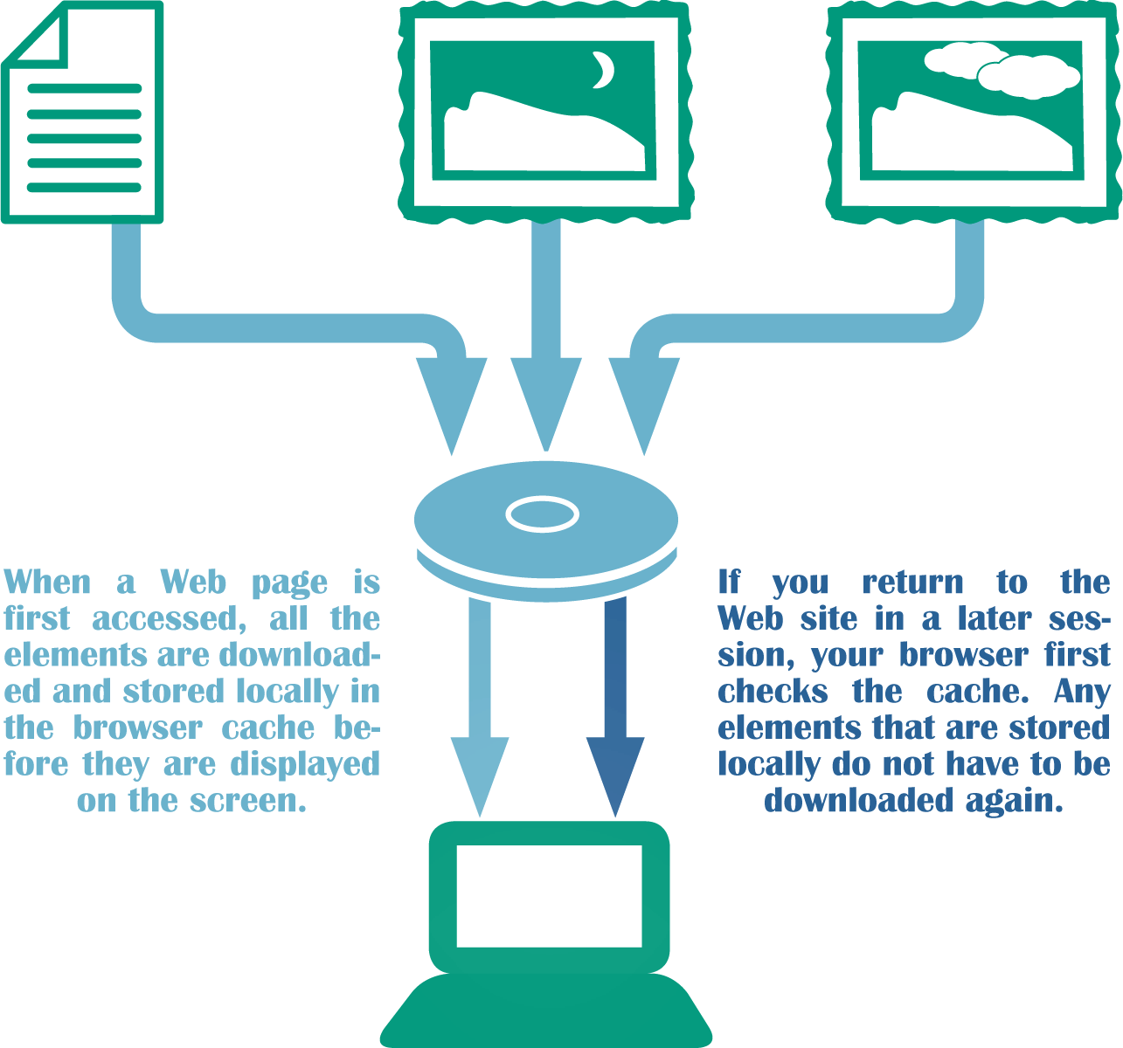
Browser Cache (1 of 6)
Browsers pull HTML documents, images, and other Web page elements to your local device; ads are pulled down too
When your browser fetches pages and graphics to form a Web page, it stores that material on your device in temporary files referred to as a browser cache, Web cache, or browser history

Slide 40
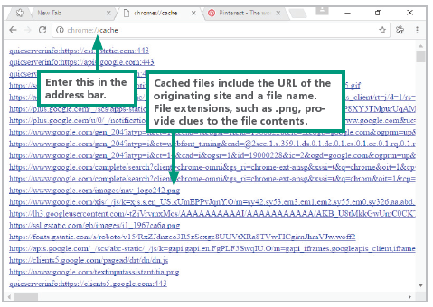
Browser Cache (2 of 6)
The information in a browser cache can be seen with browsers, such as Google Chrome, and used to see a listing of files in the browser cache and even retrieve them

Slide 41
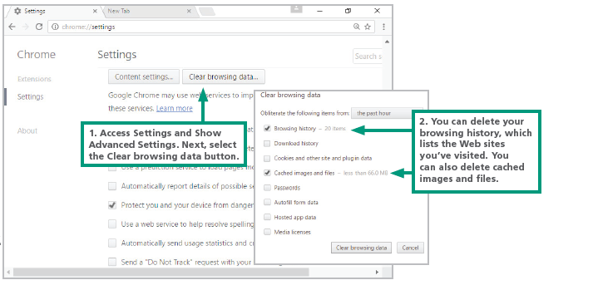
Browser Cache (3 of 6)
Browsers include settings for limiting the time cached files remain on your device, limiting the amount of space they can use on the hard disk and deleting all the cached files

Slide 42
Browser Cache (4 of 6)
In addition to the cache, your browser maintains a History list of sites that you’ve visited; you can delete the History list, usually using a process similar to clearing a browser cache
Today’s browsers also offer private browsing modes, in which traces of your activity are not maintained in the History list or browser cache; use it when you prefer not to leave a trail that can be seen by others who gain access to a device you have recently used

Slide 43
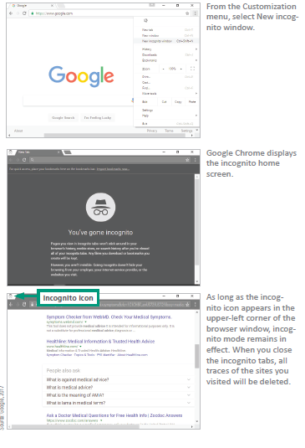
Browser Cache (5 of 6)

Slide 44
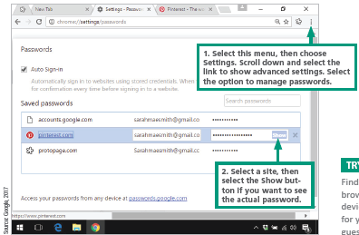
Browser Cache (6 of 6)
Browsers ask to save passwords when you log in to sites
The potential risk of stored passwords is that anyone who gains access to your device can easily log in to your password-protected sites because the passwords are supplied by your browser

Slide 45
Section C: HTML
HTML Basics
HTML Editing Tools
CSS
Dynamic Web Pages
Site Creation

Slide 46
Section C: Objectives (1 of 3)
Sketch out the family tree of HTML and similar markup languages
Identify HTML tags and state two of their characteristics
Explain the relationship between HTML documents and Web pages
List four types of tools for creating Web pages

Slide 47
Section C: Objectives (2 of 3)
Sketch out the template for a basic HTML document
List HTML tags that are commonly allowed in blog posts and comments
Describe the purpose of CSS
Differentiate inline CSS from internal and external CSS

Slide 48
Section C: Objectives (3 of 3)
Describe the differences between static Web pages and dynamic Web pages
Give examples of client-side scripting and server-side scripting
Explain the purpose of a Web hosting service

Slide 49
HTML Basics (1 of 4)
HTML is the foundation for professionally designed corporate Web sites
The current version, HTML5, was introduced in 2010
HTML is called a markup language because authors mark up documents by inserting special instructions called HTML tags that specify how the document should appear when displayed in a browser window

Slide 50
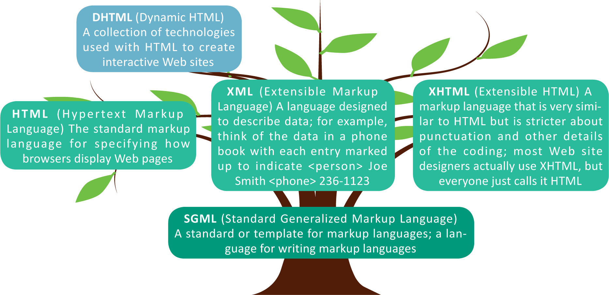
HTML Basics (2 of 4)
HTML is a member of a family of markup languages

Slide 51
HTML Basics (3 of 4)
HTML tags are incorporated into an HTML document, which is similar to a word processing file but has an .htm or .html extension
Tags, such as <h1> and <p>, are enclosed in angle brackets embedded in the document
<h1> indicates a heading
<p> indicates a new paragraph
Most tags are inserted as pairs. The start tag and end tag enclose the content like this:
<h1> THE GLOBAL CHEF </h1>
When displayed in a browser, THE GLOBAL CHEF might produce this:
THE GLOBAL CHEF

Slide 52
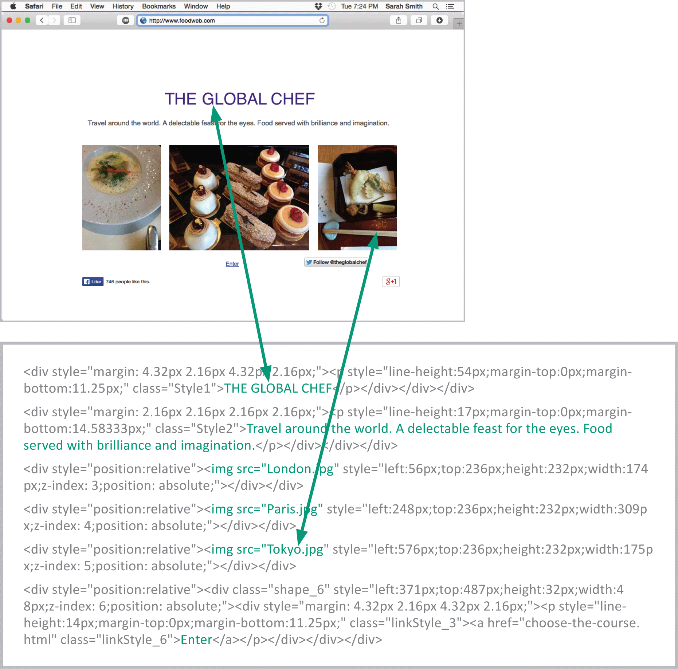
HTML Basics (4 of 4)
An HTML document is sometimes referred to as a source document because it is the source of the HTML tags used to construct a Web page

Slide 53
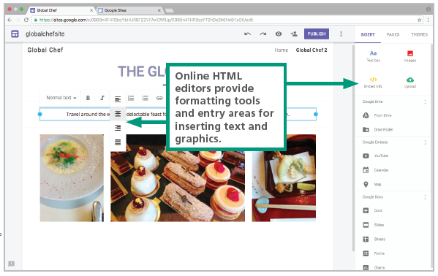
HTML Editing Tools (1 of 6)
Tools for creating Web pages
HTML conversion utility – creates an HTML document from a conventional document, spreadsheet, or other text-based file
Online HTML editor – select a template, choose a color scheme, enter titles and other text, upload graphics, and add links to other pages

Slide 54
HTML Editing Tools (2 of 6)
Locally installed HTML editor – offers professional features for managing extensive corporate Web sites; others are geared toward creating smaller personal Web sites
Text editor – With these tools, you start from scratch, with a blank page, and enter HTML codes along with the text that you want for your Web page

Slide 55
HTML Editing Tools (3 of 6)
The framework for an HTML document consists of two sections: the head and the body
An HTML document begins with the DOCTYPE and html declarations.
The <head> tag contains the page title.
The Body section contains text and links to images.
Headings are formatted with the <h1> tag and can be set off with the <p> tag.
Images are linked to pages with the <img> tag.
Links to other Web pages are coded using the <a href> tag

Slide 56
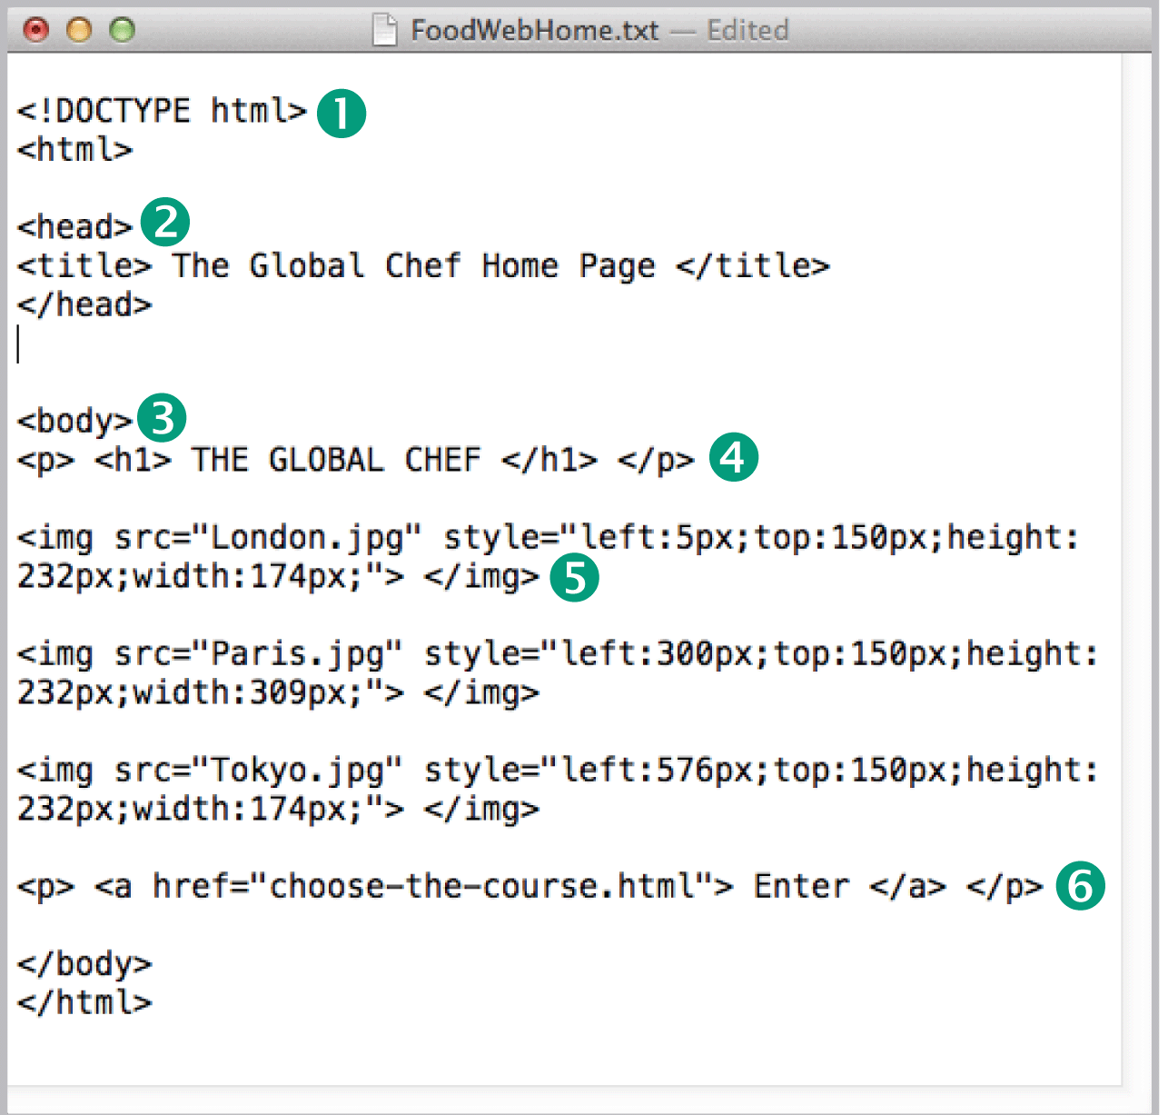
HTML Editing Tools (4 of 6)

Slide 57
HTML Editing Tools (5 of 6)
You can use tags to mark sections of text that should appear in different styles, specify images you want to appear, and create clickable links to other Web pages
HTML TAG | USE | EXAMPLE
<b> <i> | Bold or italicize text | <b> Hello </b>
<h1> <h2> ... <h6> | Change font size; h1 is largest | <h1> Chapter 1 </h1>
<hl style=“color:”> | Change font color | <hl style="color:green"> Fir Trees </h1>
<hr/> | Include a horizontal line (no end tag) | Section 2 <hr/>
<br/> | Line break (no end tag) | This is line one. <br/> This is line two.
<p> | Paragraph break | <p>lt was the best of times, it...of comparison only. </p>
<ol> <ul> <Ii> | Numbered list <ol>; bulleted list <ul>; list items <li> | <ol> <li> First item</li>,<Ii> Second item</li> </ol>
<a href=“URL”> | Link to another Web page | <a href="www.news.com/today.htm"> Click here </a>
<img src=“File”> | Include an image | <img src="Photo.jpg">
<table>, <tr>, <td> | Create tables, table rows, and cells | <table>

Slide 58
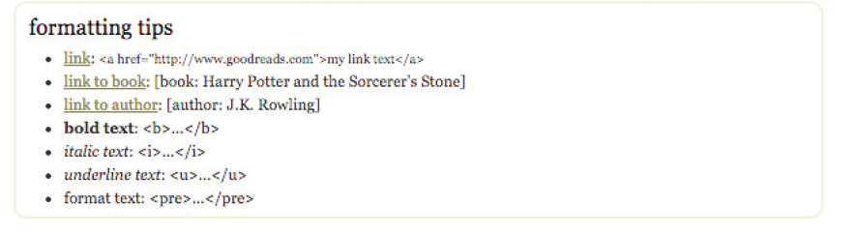
HTML Editing Tools (6 of 6)
Many blogs and social media sites accept comments from readers. You might be able to include HTML tags in your comments to enhance text and even add images
A list of html tags used to format the comments, reviews, stories & writing:

Slide 59
CSS (1 of 4)
CSS stands for Cascading Style Sheets and is a set of detailed style specifications for an HTML document
These specifications are called style rules, which include settings for font colors, font sizes, background colors, borders, text alignment, link formats, and margins
Three types of style sheets are:
Inline – style sheets can be intermixed with an HTML doc; the use of inline CSS is avoided by professional designers

Slide 60
CSS (2 of 4)
Internal – included with the header of an HTML doc; places formatting elements where they can be edited
External – style rules are placed in a separate file with a .css extension; for Web sites with more than one page, an external CSS is the recommended approach

Slide 61
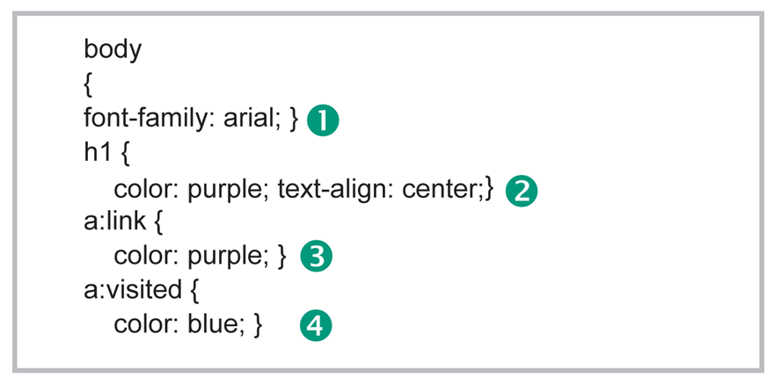
CSS (3 of 4)
A style rule:

Slide 62
CSS (4 of 4)
Set the font to Arial for the entire Web page.
Set the Heading 1 font color to purple and alignment to centered.
Set the font color of text links to purple.
Set the font color of visited text links to blue.

Slide 63
Dynamic Web Pages (1 of 3)
Using HTML and CSS, Web designers can create a static Web page that displays the same information, regardless of who accesses it
A dynamic Web page displays customized content in response to keyboard or mouse actions or based on information supplied directly or indirectly by the person viewing the page
Dynamic elements can be incorporated in Web pages with the addition of instructions, called scripts, written with scripting languages, such as JavaScript PHP, and Python

Slide 64
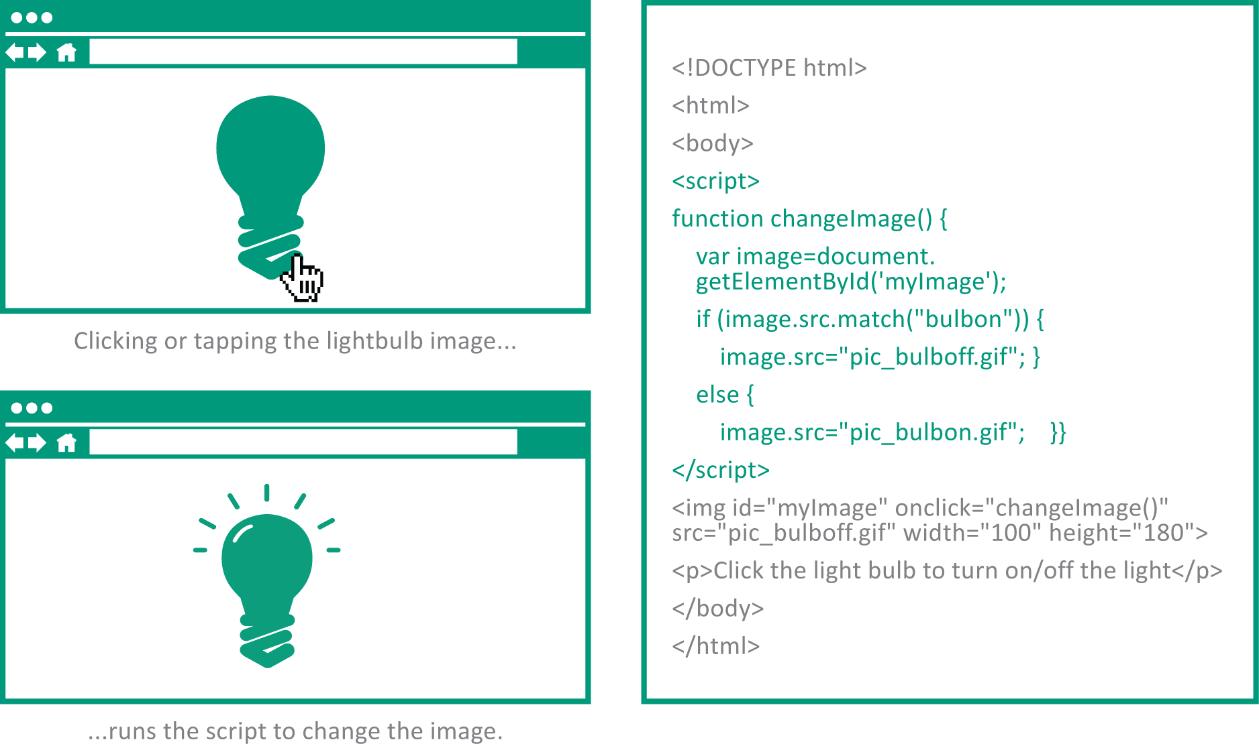
Dynamic Web Pages (2 of 3)
Client-side scripts are embedded in an HTML document and run locally when a Web page is displayed by a browser; they are used to customize aspects of the user interface and for simple interactions

Slide 65
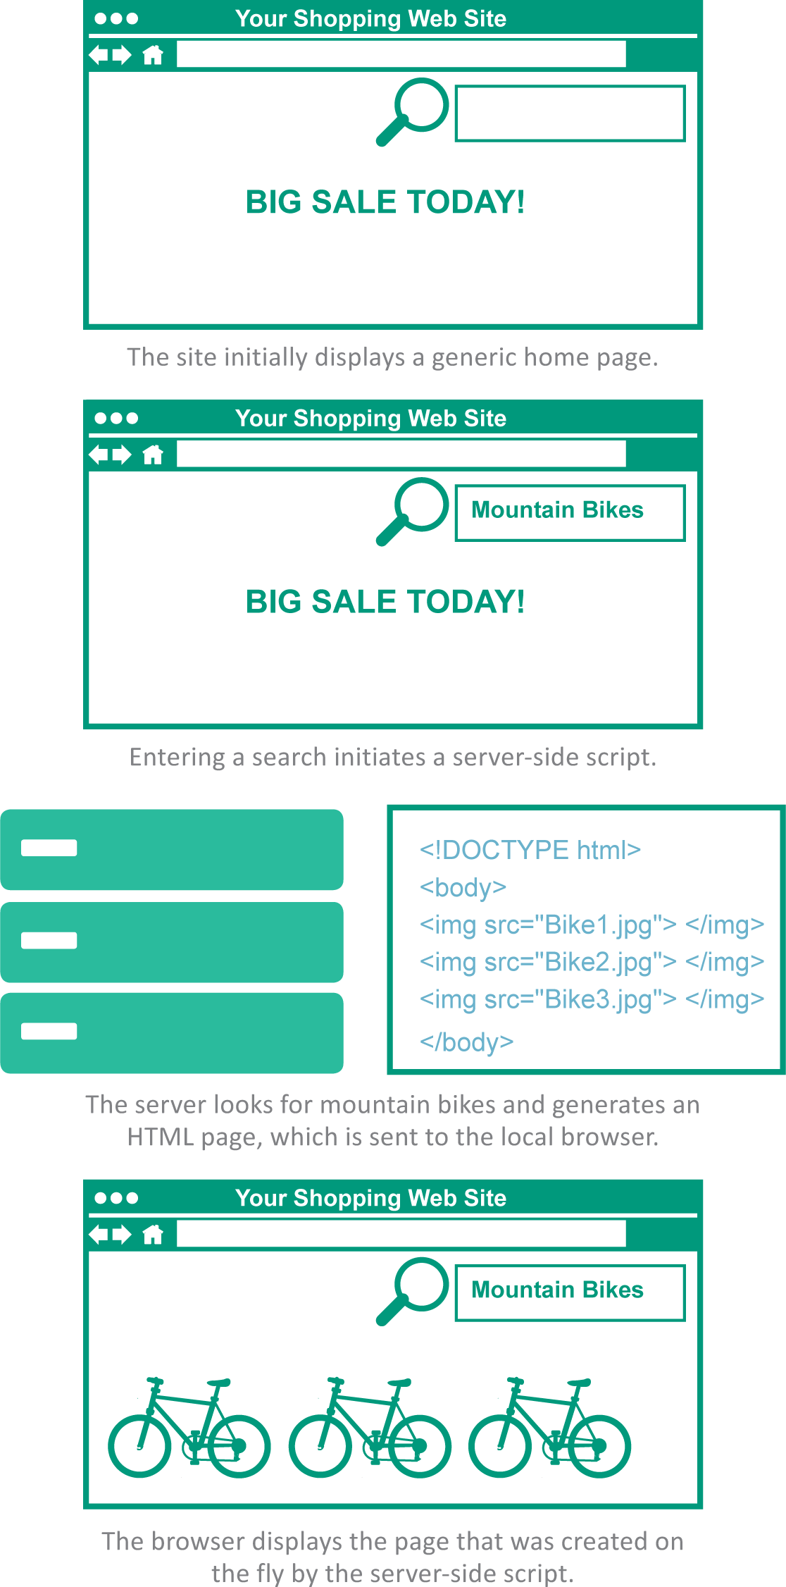
Dynamic Web Pages (3 of 3)
Server-side scripts run on Web servers rather than on your local devices; they typically access information from a database and uses that information to create customized Web pages on the fly

Slide 66
Site Creation (1 of 2)
The steps for establishing a Web site include:
Selecting a hosting service
Choosing a domain
Posting Web pages
Testing pages in various browsers

Slide 67
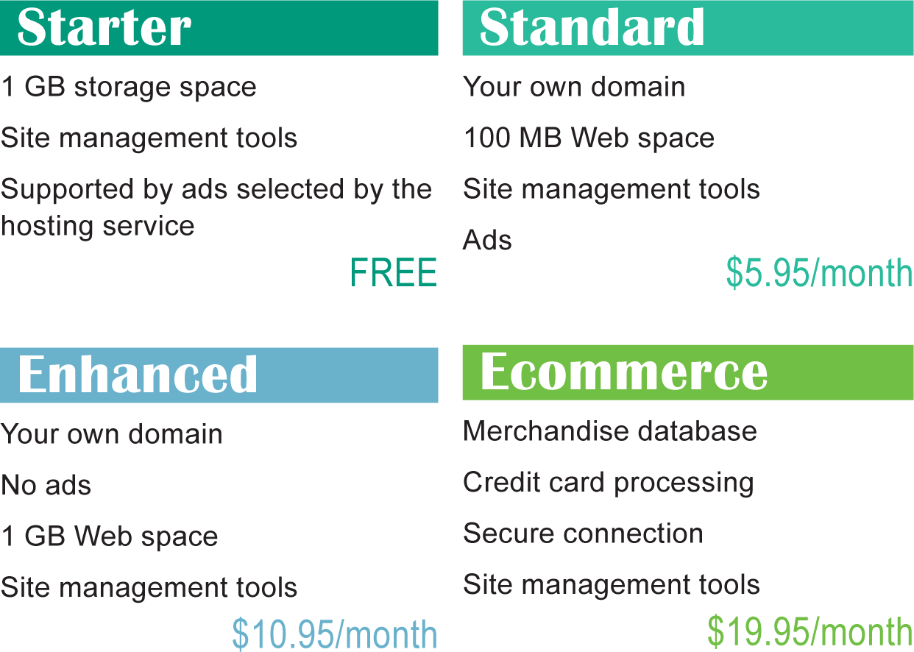
Site Creation (2 of 2)
A Web hosting service is a company that provides space on a server to house Web pages; hosting services, such as GoDaddy, offer a variety of hosting plans

Slide 68
Section D: HTTP
HTTP Basics
Cookies
HTTPS

Slide 69
Section D: Objectives (1 of 2)
List three kinds of data that a browser can request using the GET method
Identify the HTTP status codes for requests that are fulfilled and for requests that ask for a nonexistent URL
Explain the relationship between cookies and HTTP’s stateless protocol
List four reasons that Web sites use cookies

Slide 70
Section D: Objectives (2 of 2)
Describe the difference between session cookies and persistent cookies, and state which one can affect privacy
Summarize the reasons for blocking third-party cookies but not blocking first-party cookies
Identify when your browser is displaying a secure site where it is safe to enter passwords, financial information, and other personal data
Explain how public key encryption works

Slide 71
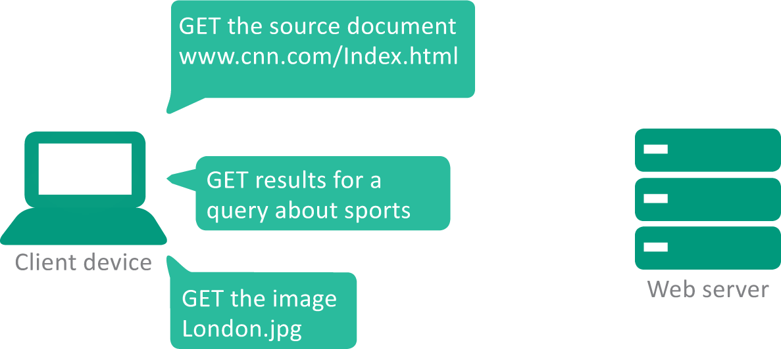
HTTP Basics (1 of 4)
HTTP is a communication protocol that works with TCP/IP to get the elements for Web pages to a local browser
A set of commands called HTTP methods help your browser communicate with Web servers

Slide 72
HTTP Basics (2 of 4)
METHOD | FUNCTION
GET | Requests data from a specified source
POST | Submits data to a specified source
HEAD | Requests the HTTP header only for requested data
PUT | Uploads data to a specific Web address
DELETE | Removes a specified resource
OPTIONS | Fetches a list of methods supported by the server

Slide 73
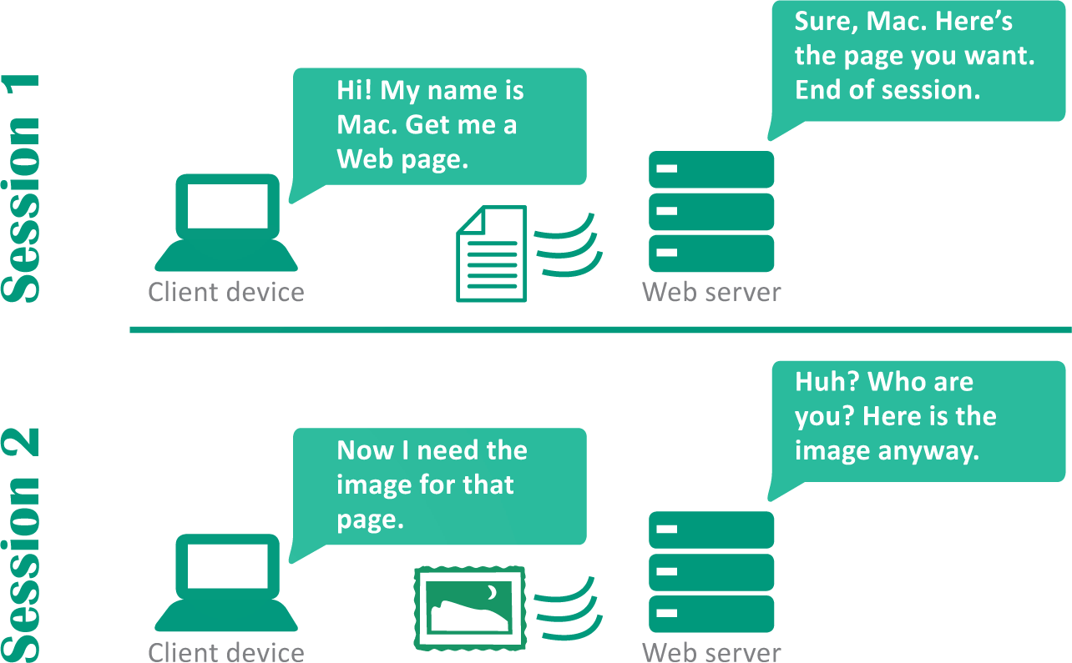
HTTP Basics (3 of 4)
An HTTP session is a sequence of transactions most commonly used to request data from a Web server and return the files needed to display a Web page in a browser window
Because the server does not “remember” its state from one session to the next, HTTP is called a stateless protocol

Slide 74
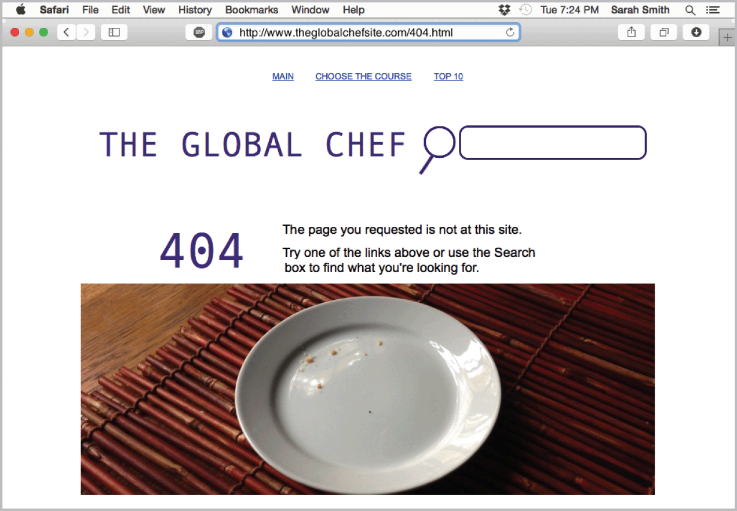
HTTP Basics (4 of 4)
A Web server’s response to a browser’s request includes an HTTP status code that indicates whether the browser’s request could be fulfilled; the status code 200 means that the request was fulfilled
A “404 Not Found” message is displayed when a Web server sends a 404 status code indicating a source doesn’t exist

Slide 75
Cookies (1 of 4)
A cookie (technically an HTTP cookie) is a small chunk of data generated by a Web server and stored as a text file in memory or on disk
Web sites use cookies to:
Monitor your path through a site
Gather information
Collect personal information
Verify that you have logged into a site using a valid ID

Slide 76
Cookies (2 of 4)
There are two kinds of cookies: session cookies and persistent cookies
Session cookies – cookies stored in memory and deleted when the browser is closed
Persistent cookies – cookies that are stored on a device after a session ends; some are programmed to time out after a designated date

Slide 77
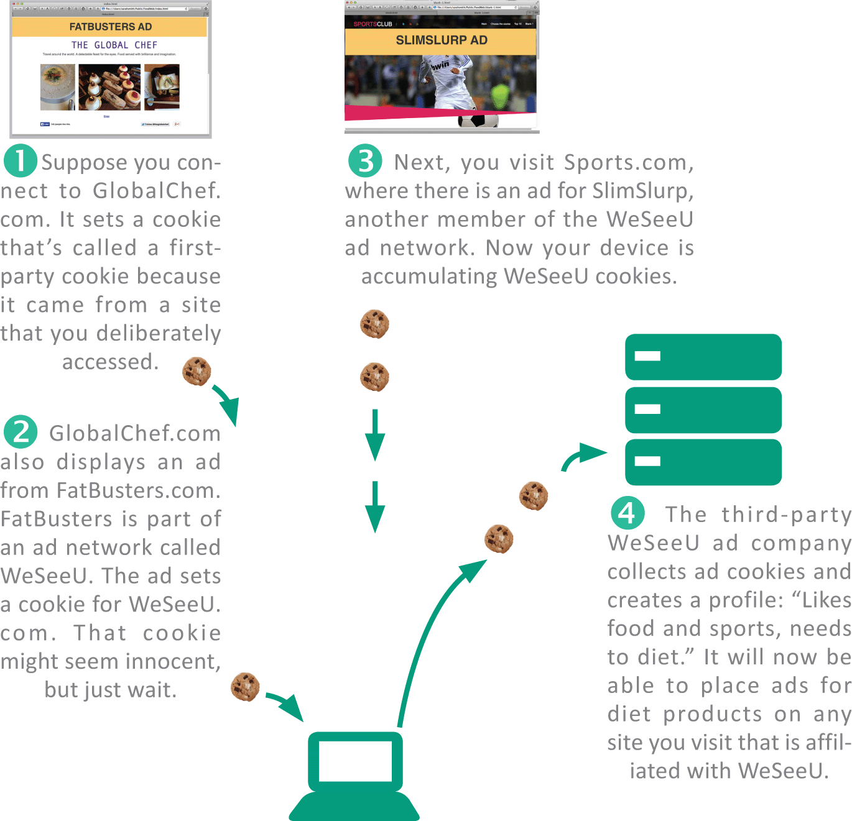
Cookies (3 of 4)
A first-party cookie is set by the domain that hosts a Web page
A third-party cookie is set by a site other than the one you connected to

Slide 78
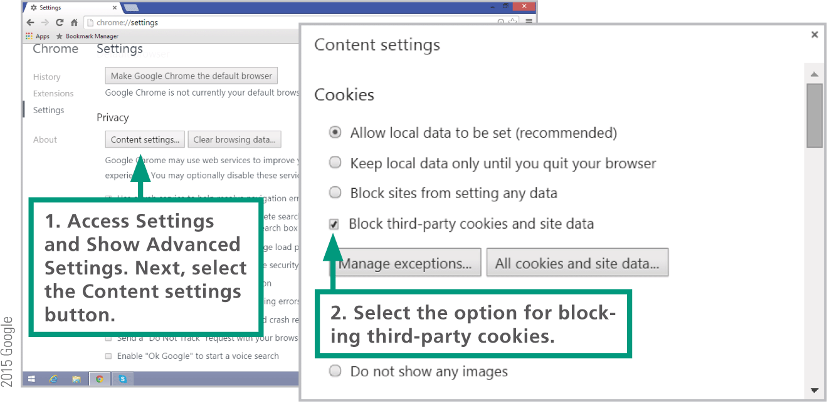
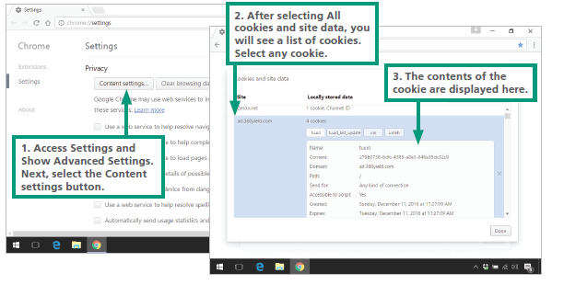
Cookies (4 of 4)

Slide 79
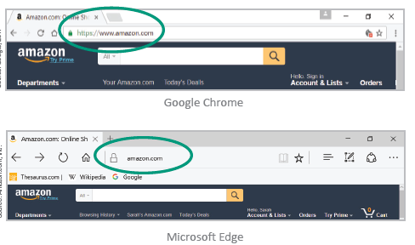
HTTPs (1 of 3)
The data that you transmit to a Web server can be secured if it is sent over an HTTP Secure connection, which encrypts the data stream between client devices and servers

Slide 80
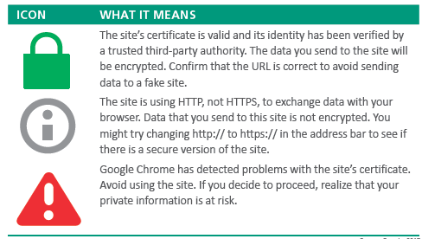
HTTPs (2 of 3)
Sites that use HTTP Secure are required to present an SSL certificate to the browser; this helps the browser verify that the site is not pretending to be another site
Look for these certificate icons when you want secure browsing:

Slide 81
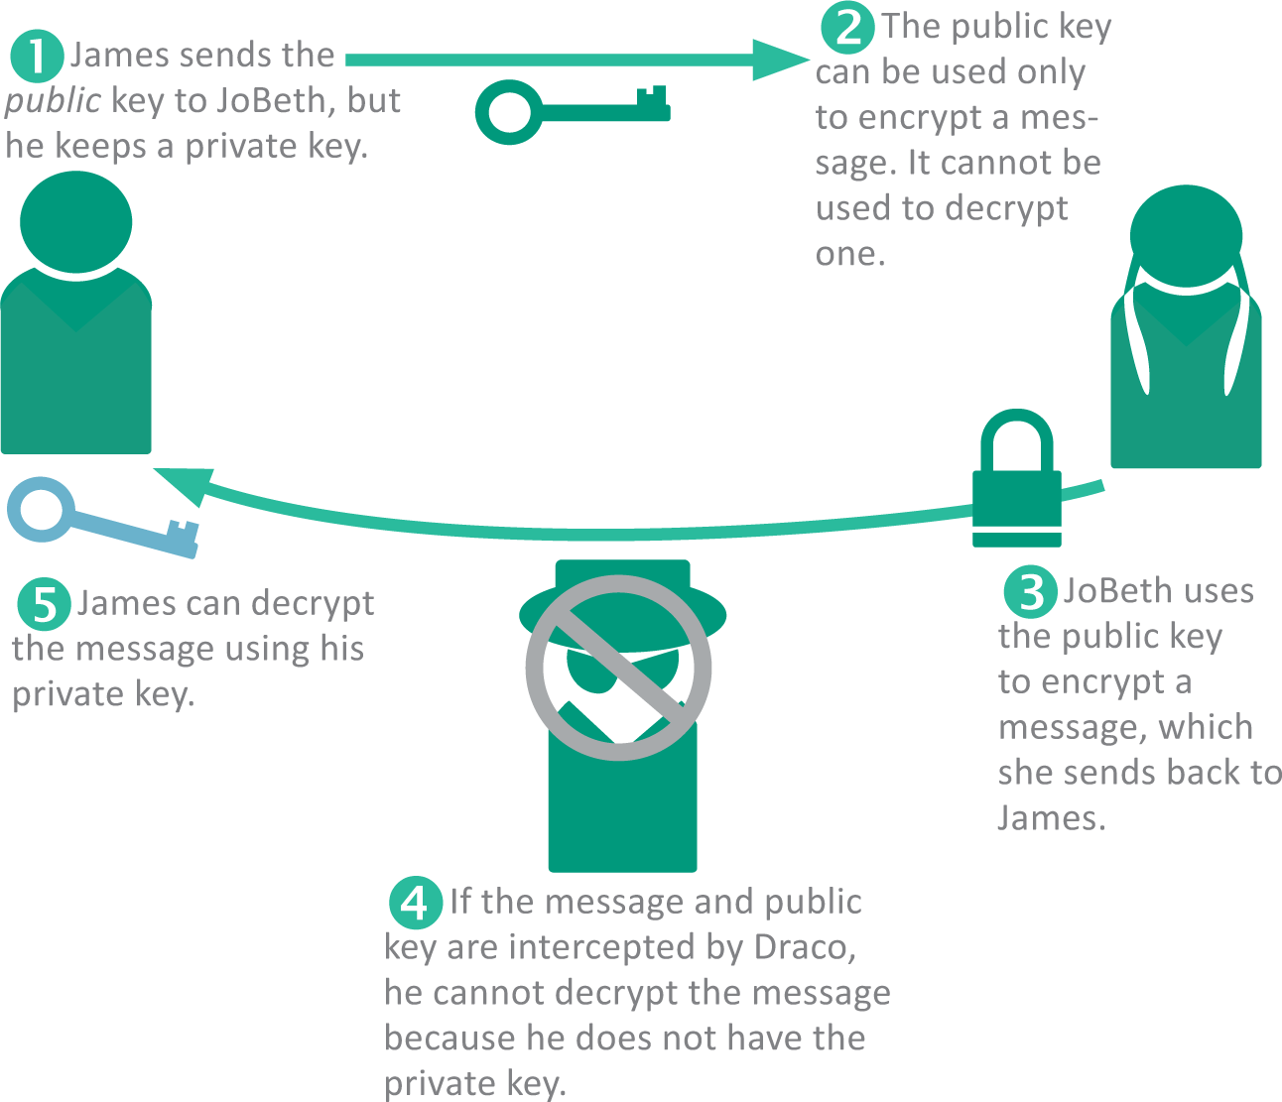
HTTPs (3 of 3)
HTTP Secure is based on HTTP and a public key encryption technology called SSL/TLS
Public key encryption is a very clever process that requires one key to encrypt data, but a different key to decrypt it; the encryption key can’t be used to decrypt the message

Slide 82
Section E: Search Engines
Search Engine Basics
Formulating Searches
Search Privacy
Using Web-based Source Material

Slide 83
Section E: Objectives (1 of 3)
List three popular search engine Web sites
List the four components of a search engine
Explain how Web crawlers traverse the Web to collect pages for search engines
Provide at least three examples of the invisible Web

Slide 84
Section E: Objectives (2 of 3)
Explain the difference between cached pages and live pages
Explain the job of a search engine indexer
List the steps executed by a query processor to respond to a query
State five techniques that can be used for search engine optimization

Slide 85
Section E: Objectives (3 of 3)
Give examples of queries using search operators such as AND, OR, NOT, quotation marks, asterisks, and range dots
Explain the significance of search history to privacy
Explain the difference between search history and browser history
Describe general guidelines for when fair use applies to content that you might incorporate in your own work

Slide 86
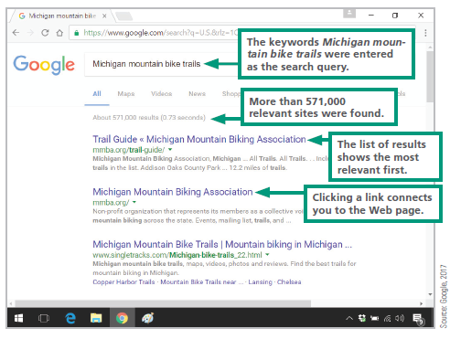
Search Engine Basics (1 of 11)
A Web search engine (commonly referred to simply as a search engine) is a computer program designed to help people locate information on the Web by formulating simple queries consisting of one or more words called keywords or search terms

Slide 87
Search Engine Basics (2 of 11)
A search engine contains four components:
Web crawler – combs the Web to gather data that’s representative of the contents of Web pages
Indexer – processes the information gathered by the crawler into a list of keywords and URLs stored in a database
Database – stores billions of index references to Web pages
Query processor – allows you to access the database by entering search terms, and then produces a list of Web pages that contain content relevant to your query

Slide 88
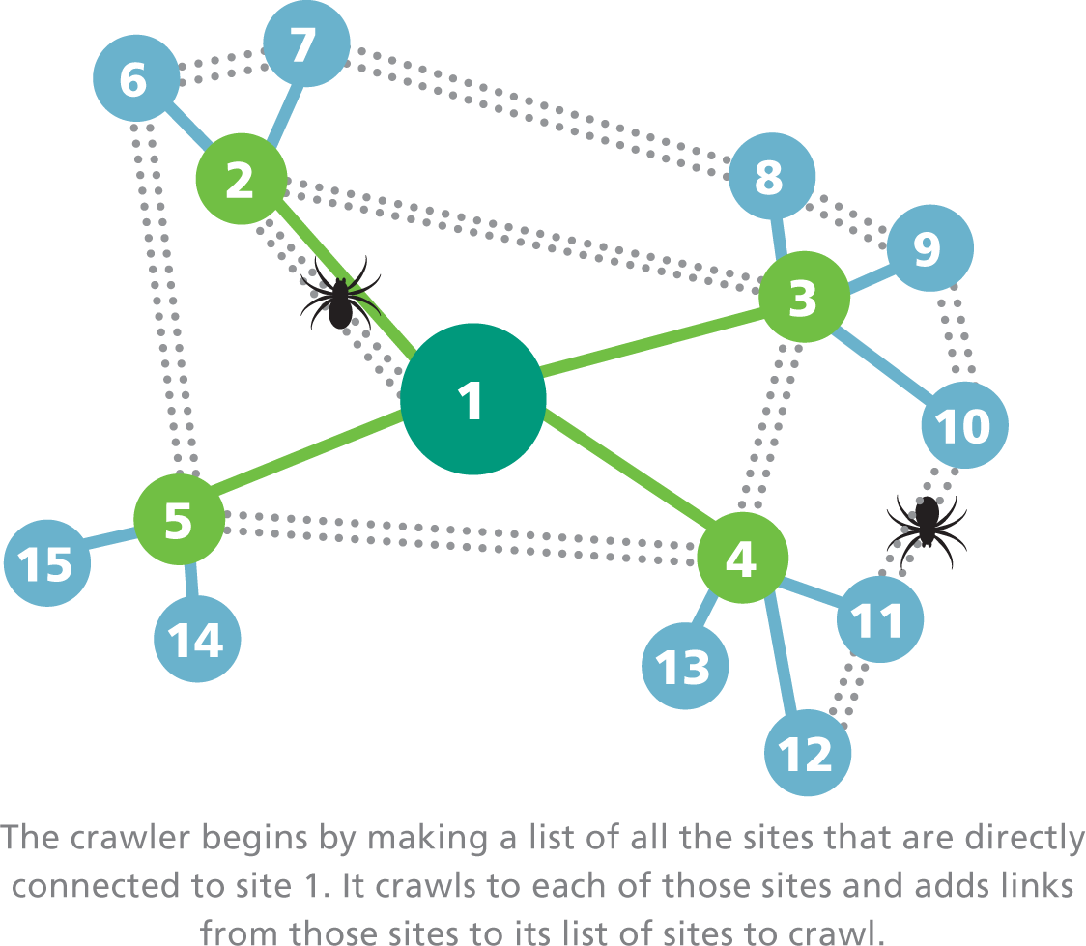
Search Engine Basics (3 of 11)
A Web crawler (also referred to as a Web spider) is a computer program that is automated to methodically visit Web sites
Web crawlers download Web pages and submit them to an indexing utility for processing
A Web crawler uses a search algorithm to traverse the Web and can run multiple processes in parallel; sophisticated algorithms keep processes from overlapping or getting stuck in loops

Slide 89
Search Engine Basics (4 of 11)
Web crawlers generally do not gather material from the invisible Web, which encompasses pages that require password-protected logins and pages that are dynamically generated with server-side scripts
The potential volume of dynamically generated pages, such as all the possible pages that Amazon.com could generate from its inventory database, is just too great to feasibly index

Slide 90
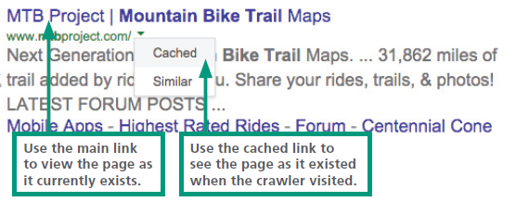
Search Engine Basics (5 of 11)
To access information related to online merchandise or library catalogs, you might have to go directly to the merchant’s or library’s Web site and use its local search tools

Slide 91
Search Engine Basics (6 of 11)
A search engine indexer is software that pulls keywords from a Web page and stores them in an index database; its purpose is to make pages easy to find based on their contents
A search engine’s query processor looks for your search terms in the search engine’s indexed database and returns a list of relevant Web sites; Google’s query processor handles more than 60,000 queries per second — on some days the total number of queries exceeds 6 billion!

Slide 92
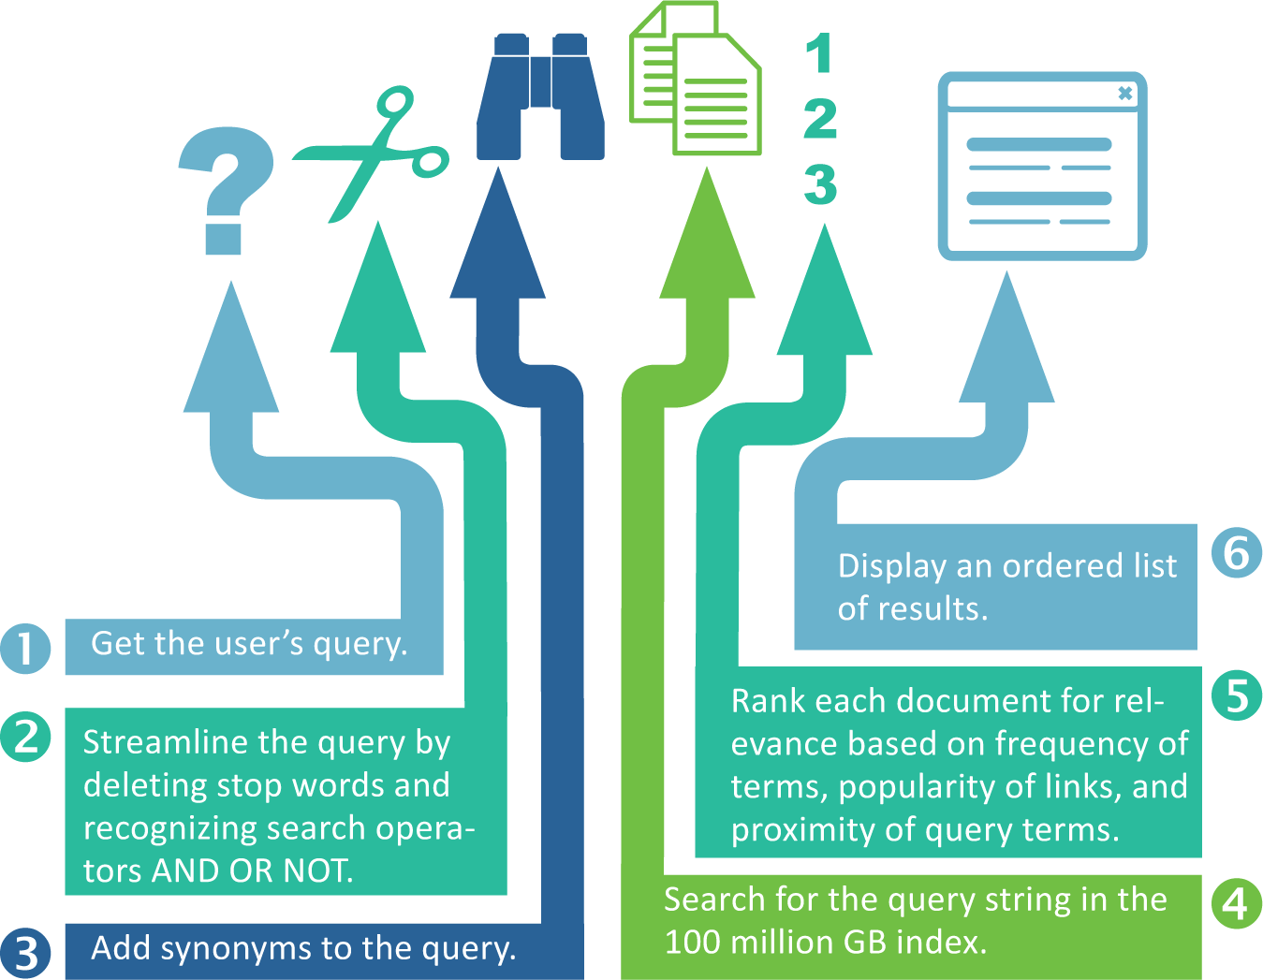
Search Engine Basics (7 of 11)

Slide 93
Search Engine Basics (8 of 11)
A query processor finds millions of pages of results matching the query; the order in which they are listed depends on the search engine’s ranking algorithm
Google keeps this algorithm a closely guarded secret so that the Web site developers can’t manipulate pages to get better placement
Link popularity is a measure of the quality and quantity of the links from one Web page to others

Slide 94
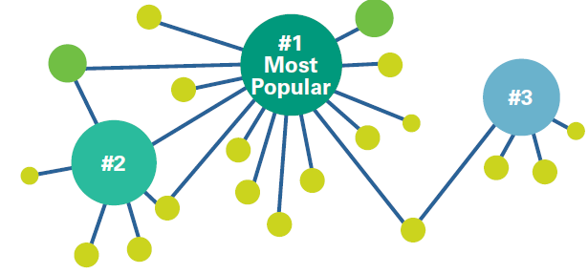
Search Engine Basics (9 of 11)

Slide 95
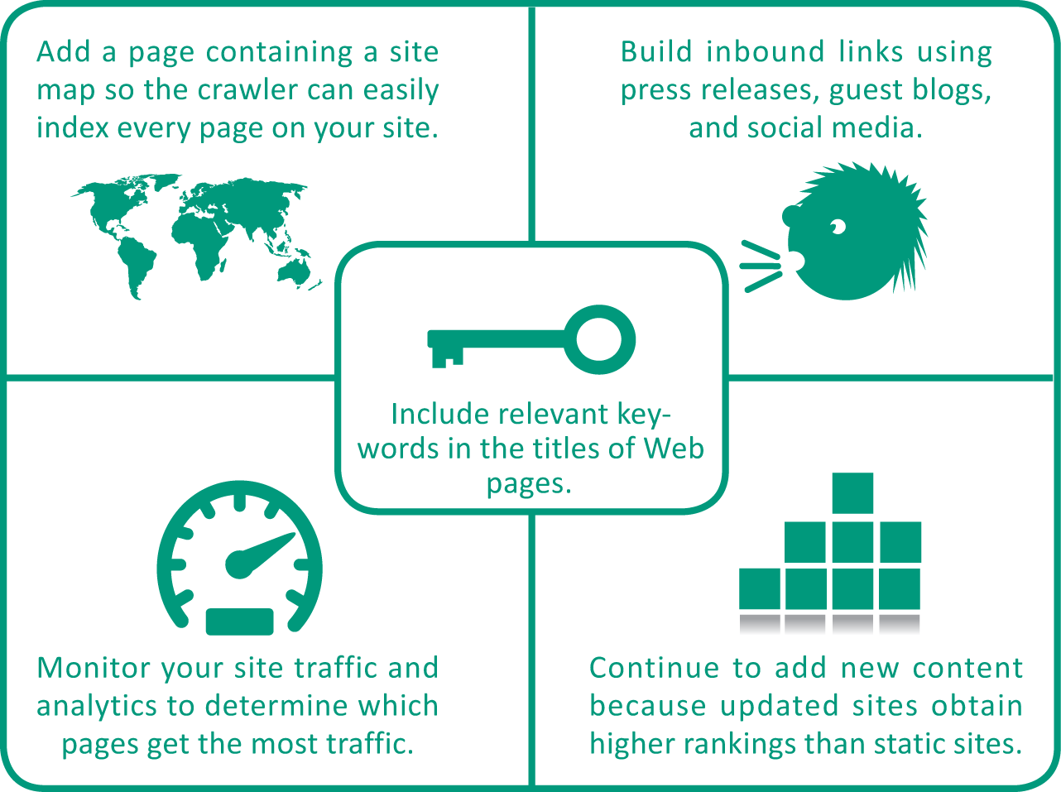
Search Engine Basics (10 of 11)
A series of techniques called search engine optimization (SEO) can affect the ranking and visibility of Web pages
Search engine companies, Google, Yahoo!, and Bing, provide guidelines for optimizing Web sites and the pages they contain

Slide 96

Search Engine Basics (11 of 11)
Some search engines accept paid ads called sponsored links, which are bumped to the top positions on the results list; other search engines also accept paid ads but place them in a clearly marked area

Slide 97

Formulating Searches (1 of 7)
Basic queries consist of a few keywords.

Slide 98
Formulating Searches (2 of 7)
Most search engines work with keyword queries in which you enter one or more words, called search terms, related to the information you want to find
Case. Most search engines are not case sensitive, so you don't have to use the Shift key when entering proper nouns
Stop words. Search engines generally ignore common "stop" words, such as and, a, and the, so don't bother to include them in your query.

Slide 99
Formulating Searches (3 of 7)
Stemming. The top search engines use stemming technology that automatically looks for plurals and other variations of the search terms you enter. For example, if you enter diet, the search engine also looks for pages with terms such as diets, dietary, and dietician.
Order. A search for time machine produces different results than a search for machine time.
Location. If your search engine is able to determine your location, your results might be affected. Most search engines give you an option to change your location or hide it.

Slide 100
Formulating Searches (4 of 7)
Context. Search engines build on your previous searches. If you formulate several Batman-related searches and then search for dark night, your search engine might assume that you are looking for information about the Batman movie The Dark Knight instead of astronomy information. Google uses this predictive technology unless you clear your Web history.

Slide 101
Formulating Searches (5 of 7)
Narrowing a search can reduce the number of results and produce a more targeted list
A search operator is a word or symbol that describes a relationship between search terms and thereby helps you create a more focused query

Slide 102
Formulating Searches (6 of 7)
AND | When two search terms are joined by AND, both terms must appear on a Web page before it can be included in the search results Batman AND movies Result: Pages about Batman movies
OR | When two search terms are joined by OR, either one or both of the search words could appear on a page. Batman OR Catwoman Result: Pages about Batman and pages about Catwoman
NOT | The search term following NOT must not appear on any of the pages found by the search engine. Batman NOT Catwoman Result: Pages about Batman and pages about Catwoman
“ ” | To search for an exact phrase, enter it in quotes. “Dynamic Duo” Result: Pages that contain the exact phrase Dynamic Duo
* | The asterisk (*) is sometimes referred to as a wildcard character. It allows a search engine to find pages with any derivation of a basic word. Bat* Result: Pages about bats, batters, Batman, batteries, etc.
. . | Google lets you use two dots to specify a range of numbers, dates, episodes, or prices. Batman episodes 5..8 Result: Pages about Batman episodes 5,6,7, and 8

Slide 103

Formulating Searches (7 of 7)
Many search engines provide ways to make your searches more precise and obtain more useful results; Google Advanced search is one example

Slide 104

Search Privacy
Your search history contains a list of queries that you’ve made in a specific search engine
Your search history is not the same as your browser history, which is a list of Web sites you’ve visited and is maintained by your browser
Search history is stored in server logs on the search engines’ computers

Slide 105

Using Web-Based Source Material (1 of 3)
Most browsers provide Copy and Save commands that allow you to obtain text and images from a Web page
To keep track of the source for each text section, you can highlight the Web page’s URL in the Address box, use the Copy command, and then paste the URL into your document

Slide 106
Using Web-Based Source Material (2 of 3)
Presenting someone else’s work as your own is plagiarism
If you copy text, pictures, or other works from a Web page, be sure to credit the original author
Information that identifies the source of an excerpted work is called a citation

Slide 107
Using Web-Based Source Material (3 of 3)
Written documents, such as reports and projects, generally include footnotes, endnotes, or inline citations formatted according to a standard style, such as MLA, APA, or Chicago
In the United States, the Fair Use Doctrine allows limited use of copyrighted material for scholarship and review without obtaining permission

